Slide 1
Characterizing Running Times
Session 04
Henry Lucky, S.Kom. M.Kom.

Slide 2
Outline Materials
Session 04
O-notation, Omega-notation, Theta-notation
Asymptotic notation
Standard notations and common functions

Slide 3
Learning outcomes
04
LO 1: Explain fundamental concept of analysis algorithms
LO 2: Apply algorithm techniques and methods
LO 3: Solve a problem using specific algorithm.
LO 4: Compare several algorithm design methods

Slide 4

O-notation, Omega-notation, Theta-notation
Informal Definition
In previous session, we have learned about $Θ$-notation.
In short, to characterize running times of algorithms: discard the lower-order terms and the coefficient of the leading term, and use a notation that focuses on the rate of growth of the running time.
$Θ$-notation is not the only such “asymptotic notation”. We’ll learn about two other asymptotic notations.

Slide 5
O-notation, Omega-notation, Theta-notation
Informal Definition
Before we get into specifics, bear in mind that the asymptotic notations we’ll see are designed so that they characterize functions in general.
Beside running times, it can also characterize some other aspect of algorithms (e.g. the amount of space they use), or even to functions that have nothing to do with algorithms.

Slide 6

O-notation, Omega-notation, Theta-notation
O-notation
O-notation characterizes an upper bound on the asymptotic behaviour of a function.
In other words, it says that a function grows no faster than a certain rate, based on the highest-order term.
For example, we have a function:
$7n^{3}+1000n^{2}−10n+1$.
Its highest-order term is $7n^{3}$, so the rate of growth is $n^{3}$.
Because this function grows no faster than $n^{3},$ we can write that it is ${O(n}^{3})$.
However, we can also write that it is ${O(n}^{4})$, because the function grows more slowly than $n^{4}$, it is true to say that it grows no faster.
More generally, it is ${O(n}^{c})$ for any constant $c≥3$.

Slide 7

O-notation, Omega-notation, Theta-notation
omega-notation
$Ω$-notation characterizes a lower bound on the asymptotic behaviour of a function.
In other words, it says that a function grows at least as fast as a certain rate, based on the highest-order term.
The highest-order term in previous function grows at least as fast as $n^{3}$, this function is $Ω(n^{3})$
However, we can also write that it is ${Ω(n}^{2})$, because the function grows faster than $n^{2}$, it is true to say that it grows at least as fast.
More generally, it is ${Ω(n}^{c})$ for any constant $c≤3$.

Slide 8

O-notation, Omega-notation, Theta-notation
Theta-notation
$Θ$-notation characterizes a tight bound on the asymptotic behaviour of a function.
It says that a function grows precisely at a certain rate, based on the highest-order term.
$Θ$-notation characterizes the rate of growth of the function to within a constant factor from above and to within a constant factor from below. These two constant factors need not be equal.
Notes:
Theta-notation characterizes the rate of growth of a function by providing both an upper bound (big-O) and a lower bound (Omega) on the function's growth rate. When we say "the factors need not be equal," it means that the constant factors multiplying the upper bound and lower bound terms in the notation may differ.
For example, if a function has an upper bound of O(n^2) and a lower bound of Omega(n), the factors in front of n^2 and n can be different. The upper bound might be represented by a constant factor of, say, 5n^2, while the lower bound could be represented by a constant factor of 0.5n.

Slide 9

O-notation, Omega-notation, Theta-notation
Theta-notation
So, if you can show that a function is both $Ο(f\left(n\right))$ and $Ω(f\left(n\right))$ for some function $f(n)$, then you have shown that the function is also $Θ(f\left(n\right))$.
For example, since the previous function is both $Ο(n^{3})$ and $Ω(n^{3})$, the function is also $Θ(n^{3})$.
Notes:
Theta-notation characterizes the rate of growth of a function by providing both an upper bound (big-O) and a lower bound (Omega) on the function's growth rate. When we say "the factors need not be equal," it means that the constant factors multiplying the upper bound and lower bound terms in the notation may differ.
For example, if a function has an upper bound of O(n^2) and a lower bound of Omega(n), the factors in front of n^2 and n can be different. The upper bound might be represented by a constant factor of, say, 5n^2, while the lower bound could be represented by a constant factor of 0.5n.

Slide 10
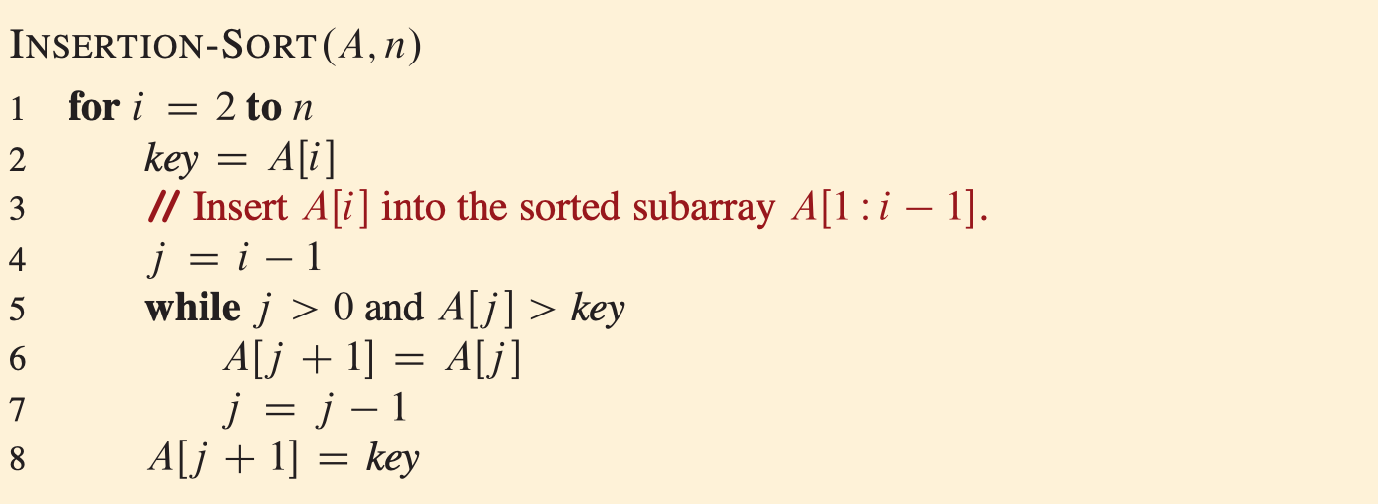
O-notation, Omega-notation, Theta-notation
Example: insertion sort

Slide 11

O-notation, Omega-notation, Theta-notation
Example: insertion sort
From the procedure, we can observe that it has nested loops. The outer (for) that runs n-1 times and the inner (while) loop which might runs 0 times, i-1 times, or anywhere in between.
These observation suffice to deduce an $O(n^{2})$ running time for any case of Insertion-Sort, giving us a blanket statement that covers all inputs.
We can also see that the worst-case running time is $Ω(n^{2})$. It means that for every input size $n$ above a certain threshold, there is at least one input of size $n$ for which the algorithm takes at least $cn^{2}$ time, for some positive constant $c$.

Slide 12
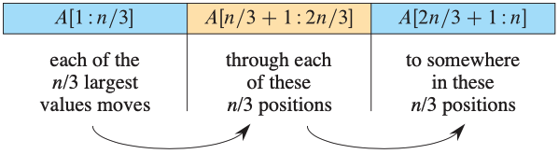

O-notation, Omega-notation, Theta-notation
Example: insertion sort
Let’s assume that n is multiple of 3 so we can divide the array into $n/3$ positions.
If the first $n/3$positions contain $n/3$largest values, each of the values must move though each of the middle $n/3$positions, one position at a time, to end up somewhere in the last $n/3$positions.
Then, the time taken is at least proportional to$(n/3) (n/3) =n^{2}/9$, or $Ω(n^{2})$.

Slide 13

O-notation, Omega-notation, Theta-notation
Example: insertion sort
Because we have shown that Insertion-Sort runs in $O(n^{2})$ time in all cases and that there is an input that makes it take $Ω(n^{2})$ time, we conclude that the worst-case running time of Insertion sort is $Θ(n^{2})$
This argument doesn’t show that it runs in $Θ(n^{2})$ time in all cases. Indeed, because the best-case running time is $Θ(n)$.

Slide 14
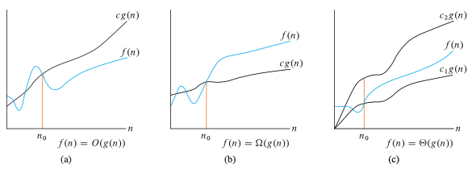

Asymptotic notation
Formal definitions
Graphic examples of the $Ο, Ω, and Θ$notations.
Look closely, there are other constants such as $n_{0}, c,c_{1}$, $c_{2}$ used here.

Slide 15

Asymptotic notation
Formal definitions
$Ο$-notation (Big-Oh or Oh)
$$Ο\left(g\left(n\right)\right)=\{ f\left(n\right) :there exist positive constants c and n_{0} such that$$
$$0 ≤f\left(n\right)≤cg\left(n\right) for all n ≥ n_{0}\}$$
$Ω$-notation (Big-Omega or Omega)
$$Ω\left(g\left(n\right)\right)=\{ f\left(n\right) :there exist positive constants c and n_{0} such that$$
$$0≤cg\left(n\right)≤f\left(n\right) for all n ≥ n_{0}\}$$
$Θ$-notation (Big-Theta or Theta)
$$Θ\left(g\left(n\right)\right)=\{ f\left(n\right) :there exist positive constants c_{1}\text{, }c_{2}, and n_{0} such that$$
$$0≤c_{1}g\left(n\right)≤f\left(n\right)≤c_{2}g\left(n\right) for all n ≥ n_{0}\}$$

Slide 16

Asymptotic notation
Formal definitions
These definitions lead to following theorem:
For any two functions $f\left(n\right)$ and $g\left(n\right)$, we have $f\left(n\right)=Θ(g\left(n\right))$ if and only if $f\left(n\right)=O(g\left(n\right))$ and $f\left(n\right)=Ω(g\left(n\right))$.

Slide 17

Asymptotic notation
Formal definitions example
We already shown that $4n^{2}+100n+500=O(n^{2})$, We will show that $4n^{2}+100n+500=O(n^{2})$, even though the lower-order terms have much larger coefficients than the leading term.
We need to find positive constants c and $n_{0}$ such that $4n^{2}+100n+500≤cn^{2}$ for all $n ≥ n_{0}$.
$$4n^{2}+100n+500≤cn^{2} −divide both sides with n^{2}$$
$$4+100/n+500/n^{2}≤c$$
Inequality above is satisfied for many choices of c and $n_{0}$.

Slide 18

Asymptotic notation
Formal definitions example
For example, if we choose $n_{0}=1$, then the inequality holds for $c=604$. if we choose $n_{0}=10$, then $c=19$ works.
We already shown that $4n^{2}+100n+500=O(n^{2})$, now let’s show that $4n^{2}+100n+500=Ω(n^{2})$!

Slide 19

Asymptotic notation
other Formal definitions
$o$-notation (little-oh)
$$o\left(g\left(n\right)\right)=\{ f\left(n\right) :there exist positive constants c and n_{0} such that$$
$$0 ≤f\left(n\right)<cg\left(n\right) for all n ≥ n_{0}\}$$
$ω$-notation (little-omega)
$$Ω\left(g\left(n\right)\right)=\{ f\left(n\right) :there exist positive constants c and n_{0} such that$$
$$0≤cg\left(n\right)<f\left(n\right) for all n ≥ n_{0}\}$$

Slide 20

Asymptotic notation
proper use of asymptotic notations to characterize running times
Insertion sort:
We can correctly say that insertion sort’s worst-case running time is $O(n^{2})$, $Ω(n^{2})$, and $Θ\left(n^{2}\right).$
Although all three ways are correct, the $Θ\left(n^{2}\right)$ bound is the most precise and hence the most preferred.
We can correctly say that insertion sort’s best-case running time is $O(n)$, $Ω(n)$, and $Θ\left(n\right).$

Slide 21

Asymptotic notation
proper use of asymptotic notations to characterize running times
Merge sort:
Since merge sort runs in $Θ(n\lg{ n})$ time in all cases, we don’t have to specify worst-case, best-case or any other cases.
If an algorithm has a running time of $3n^{2}+20n$ in all cases, it’s best to use $Θ(n^{2})$. $O(n^{3})$ or $Θ(3n^{2}+20n)$ is also correct, however neither is as useful as writing $Θ(n^{2})$ in this case.

Slide 22

Asymptotic notation
Wrong use of asymptotic notations to characterize running times
Insertion sort:
Insertion sort’s running time is $Θ\left(n^{2}\right)$ or $Θ\left(n\right)$. <- Overstatement, because by omitting “worst-case”, we’re left with a blanket statement covering all cases.
Insertion sort’s running time is $O\left(n^{2}\right)$. <- Correct, in all cases, its running time grows no faster than $n^{2}$.
Insertion sort’s running time is $Ω\left(n\right)$<- Correct, its running time grows at least as fast as $n$.

Slide 23

Asymptotic notation
Wrong use of asymptotic notations to characterize running times
People occasionally conflate $O$-notation with $Θ$-notation by mistakenly using $O$-notation to indicate an asymptotically tight bound.
“An $O(n\lg{n})$-time algorithm runs faster than an $O(n^{2})$-time algorithm”. <- Incorrect, O-notation denotes only an asymptotic upper bound, that so-called $O(n^{2})$-time algorithm might run in $Θ(n)$-time.

Slide 24
Standard notations and common functions
Mathematical functions and notations
There are several functions and notations that you need to know to be able to compare asymptotic notations:
Monotonicity
Polynomials
Exponentials
Logarithms
Factorials
Functional iteration
The iterated logarithm function
Fibonacci numbers

Slide 25
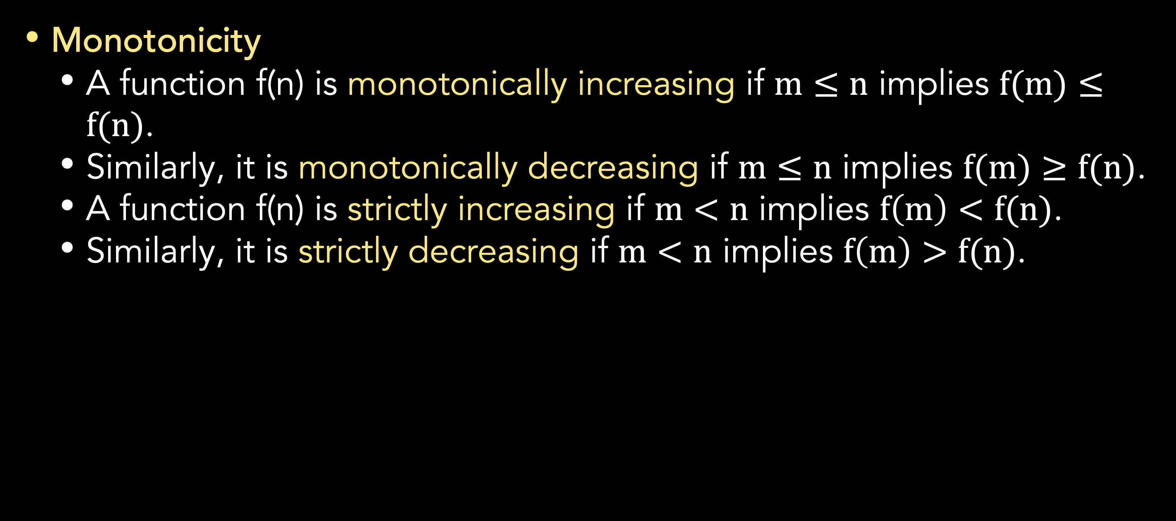
Standard notations and common functions
Mathematical functions and notations
Monotonicity
A function f(n) is monotonically increasing if $m≤n$ implies $f(m)≤f(n)$.
Similarly, it is monotonically decreasing if $m≤n$ implies $f(m)≥f(n)$.
A function f(n) is strictly increasing if $m<n$ implies $f\left(m\right)<f(n)$.
Similarly, it is strictly decreasing if $m<n$ implies $f\left(m\right)>f(n)$.

Slide 26
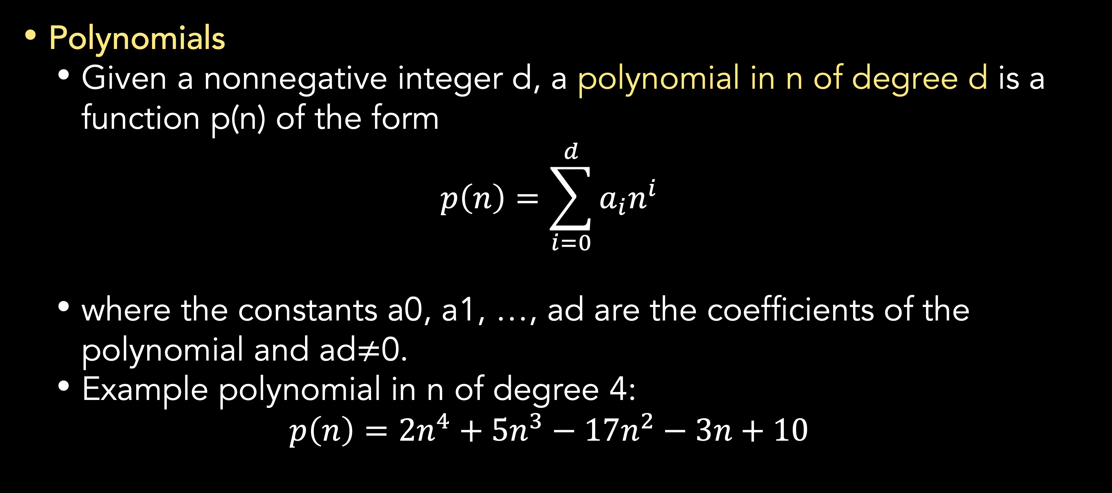
Standard notations and common functions
Mathematical functions and notations
Polynomials
Given a nonnegative integer d, a polynomial in n of degree d is a function p(n) of the form
$$p\left(n\right)=\sum_{i=0}^{d}{a_{i}n^{i}}$$
where the constants a0, a1, …, ad are the coefficients of the polynomial and ad$≠$0.
Example polynomial in n of degree 4:
$$p\left(n\right)=2n^{4}+5n^{3}−17n^{2}−3n+10$$

Slide 27
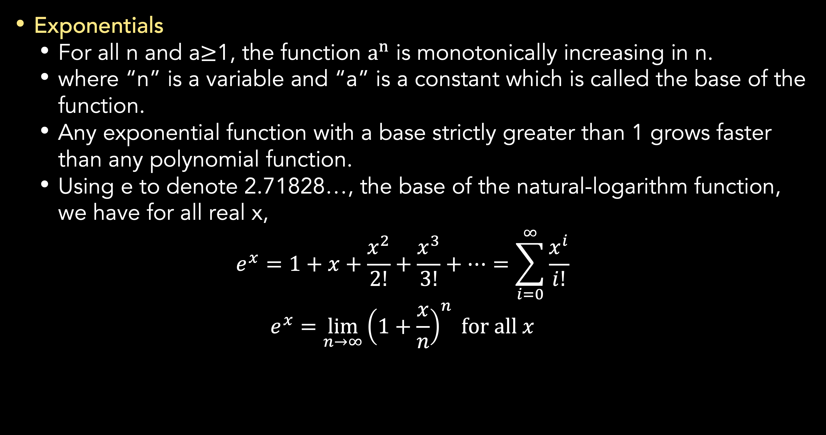
Standard notations and common functions
Mathematical functions and notations
Exponentials
For all n and a$≥$1, the function $a^{n}$ is monotonically increasing in n.
where “n” is a variable and “a” is a constant which is called the base of the function.
Any exponential function with a base strictly greater than 1 grows faster than any polynomial function.
Using e to denote 2.71828…, the base of the natural-logarithm function, we have for all real x,
$$e^{x}=1+x+\frac{x^{2}}{2!}+\frac{x^{3}}{3!}+…=\sum_{i=0}^{∞}{\frac{x^{i}}{i!}}$$
$$e^{x}=\lim_{n→∞}{{\left(1+\frac{x}{n}\right)}^{n}} for all x$$

Slide 28
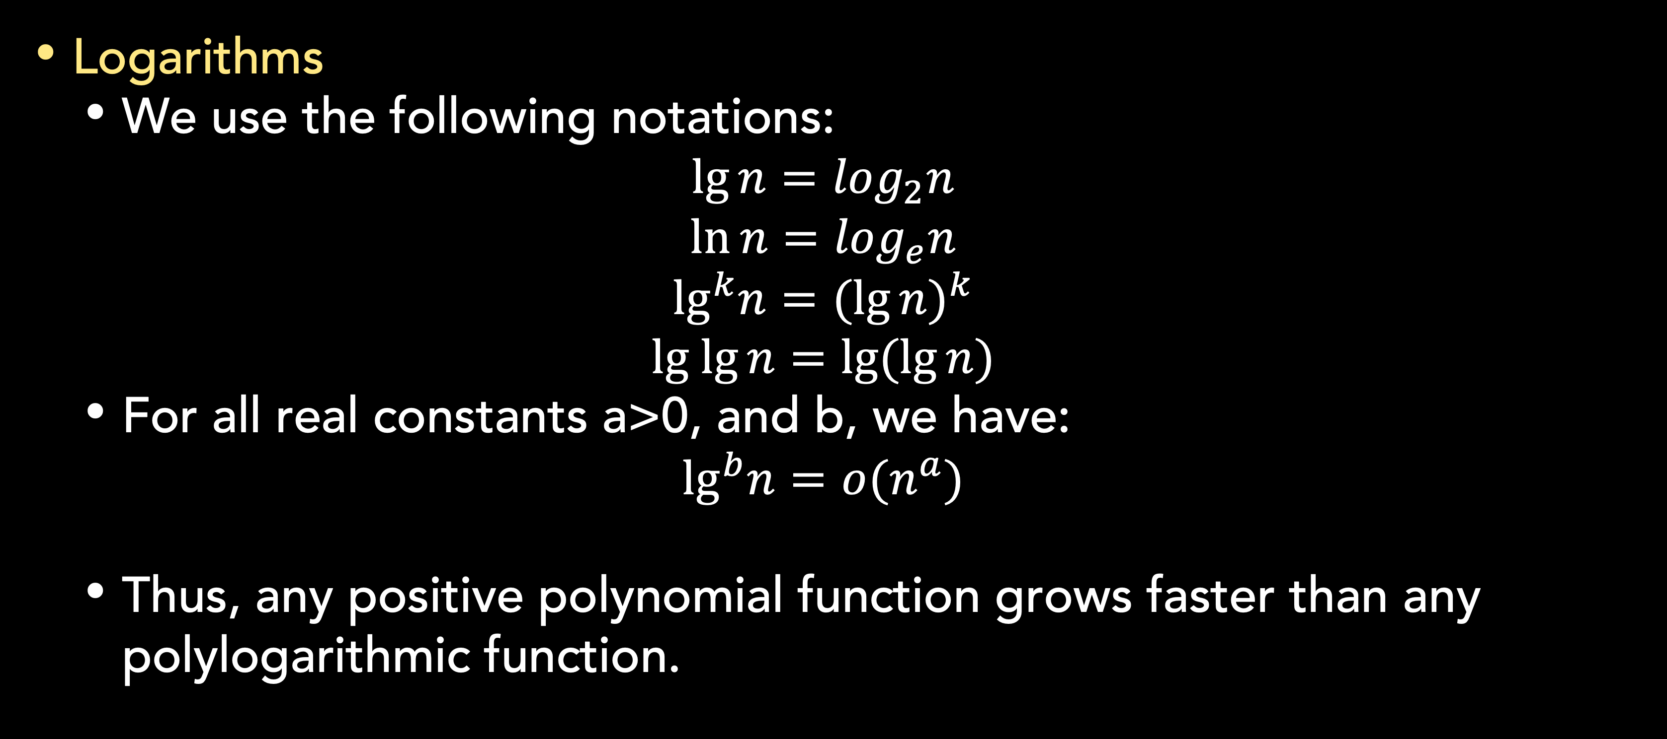
Standard notations and common functions
Mathematical functions and notations
Logarithms
We use the following notations:
$$\lg{n}=\log_{2}n$$
$$\ln{n}=\log_{e}n$$
$$\lg^{k}n={(\lg{n})}^{k}$$
$$lg lg{n}=\lg{(\lg{n})}$$
For all real constants a>0, and b, we have:
$$\lg^{b}n=o(n^{a})$$
Thus, any positive polynomial function grows faster than any polylogarithmic function.

Slide 29
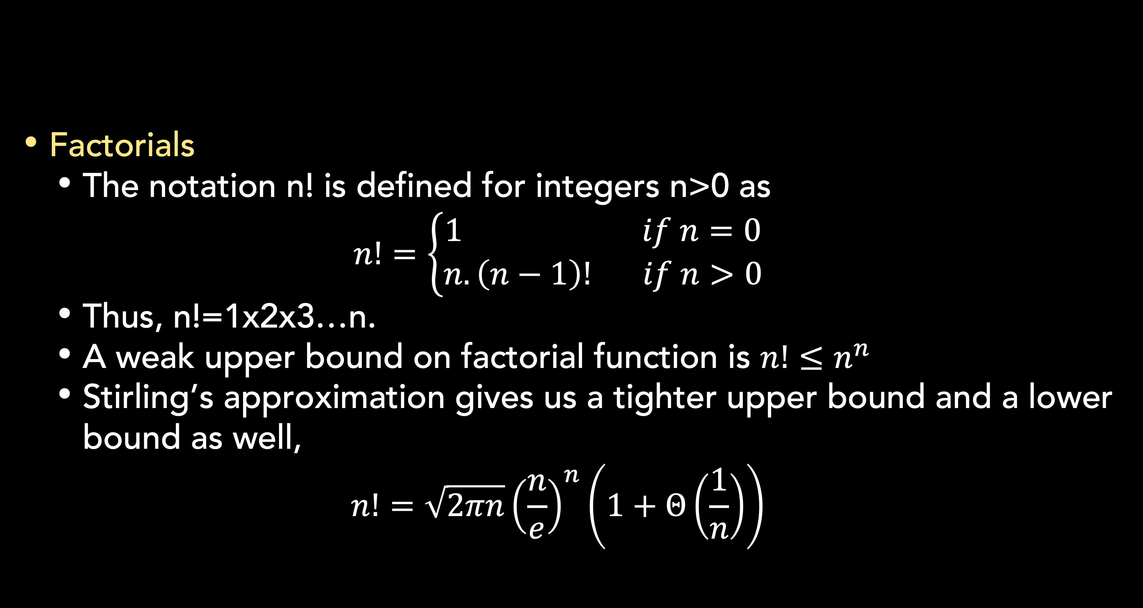
Standard notations and common functions
Mathematical functions and notations
Factorials
The notation n! is defined for integers n>0 as
$$n!=\left\{\begin{aligned}1 if n=0 \\ n.\left(n−1\right)! if n>0\end{aligned}\right.$$
Thus, n!=1x2x3…n.
A weak upper bound on factorial function is $n!≤n^{n}$
Stirling’s approximation gives us a tighter upper bound and a lower bound as well,
$$n!=\sqrt{2πn}{\left(\frac{n}{e}\right)}^{n}\left(1+Θ\left(\frac{1}{n}\right)\right)$$

Slide 30
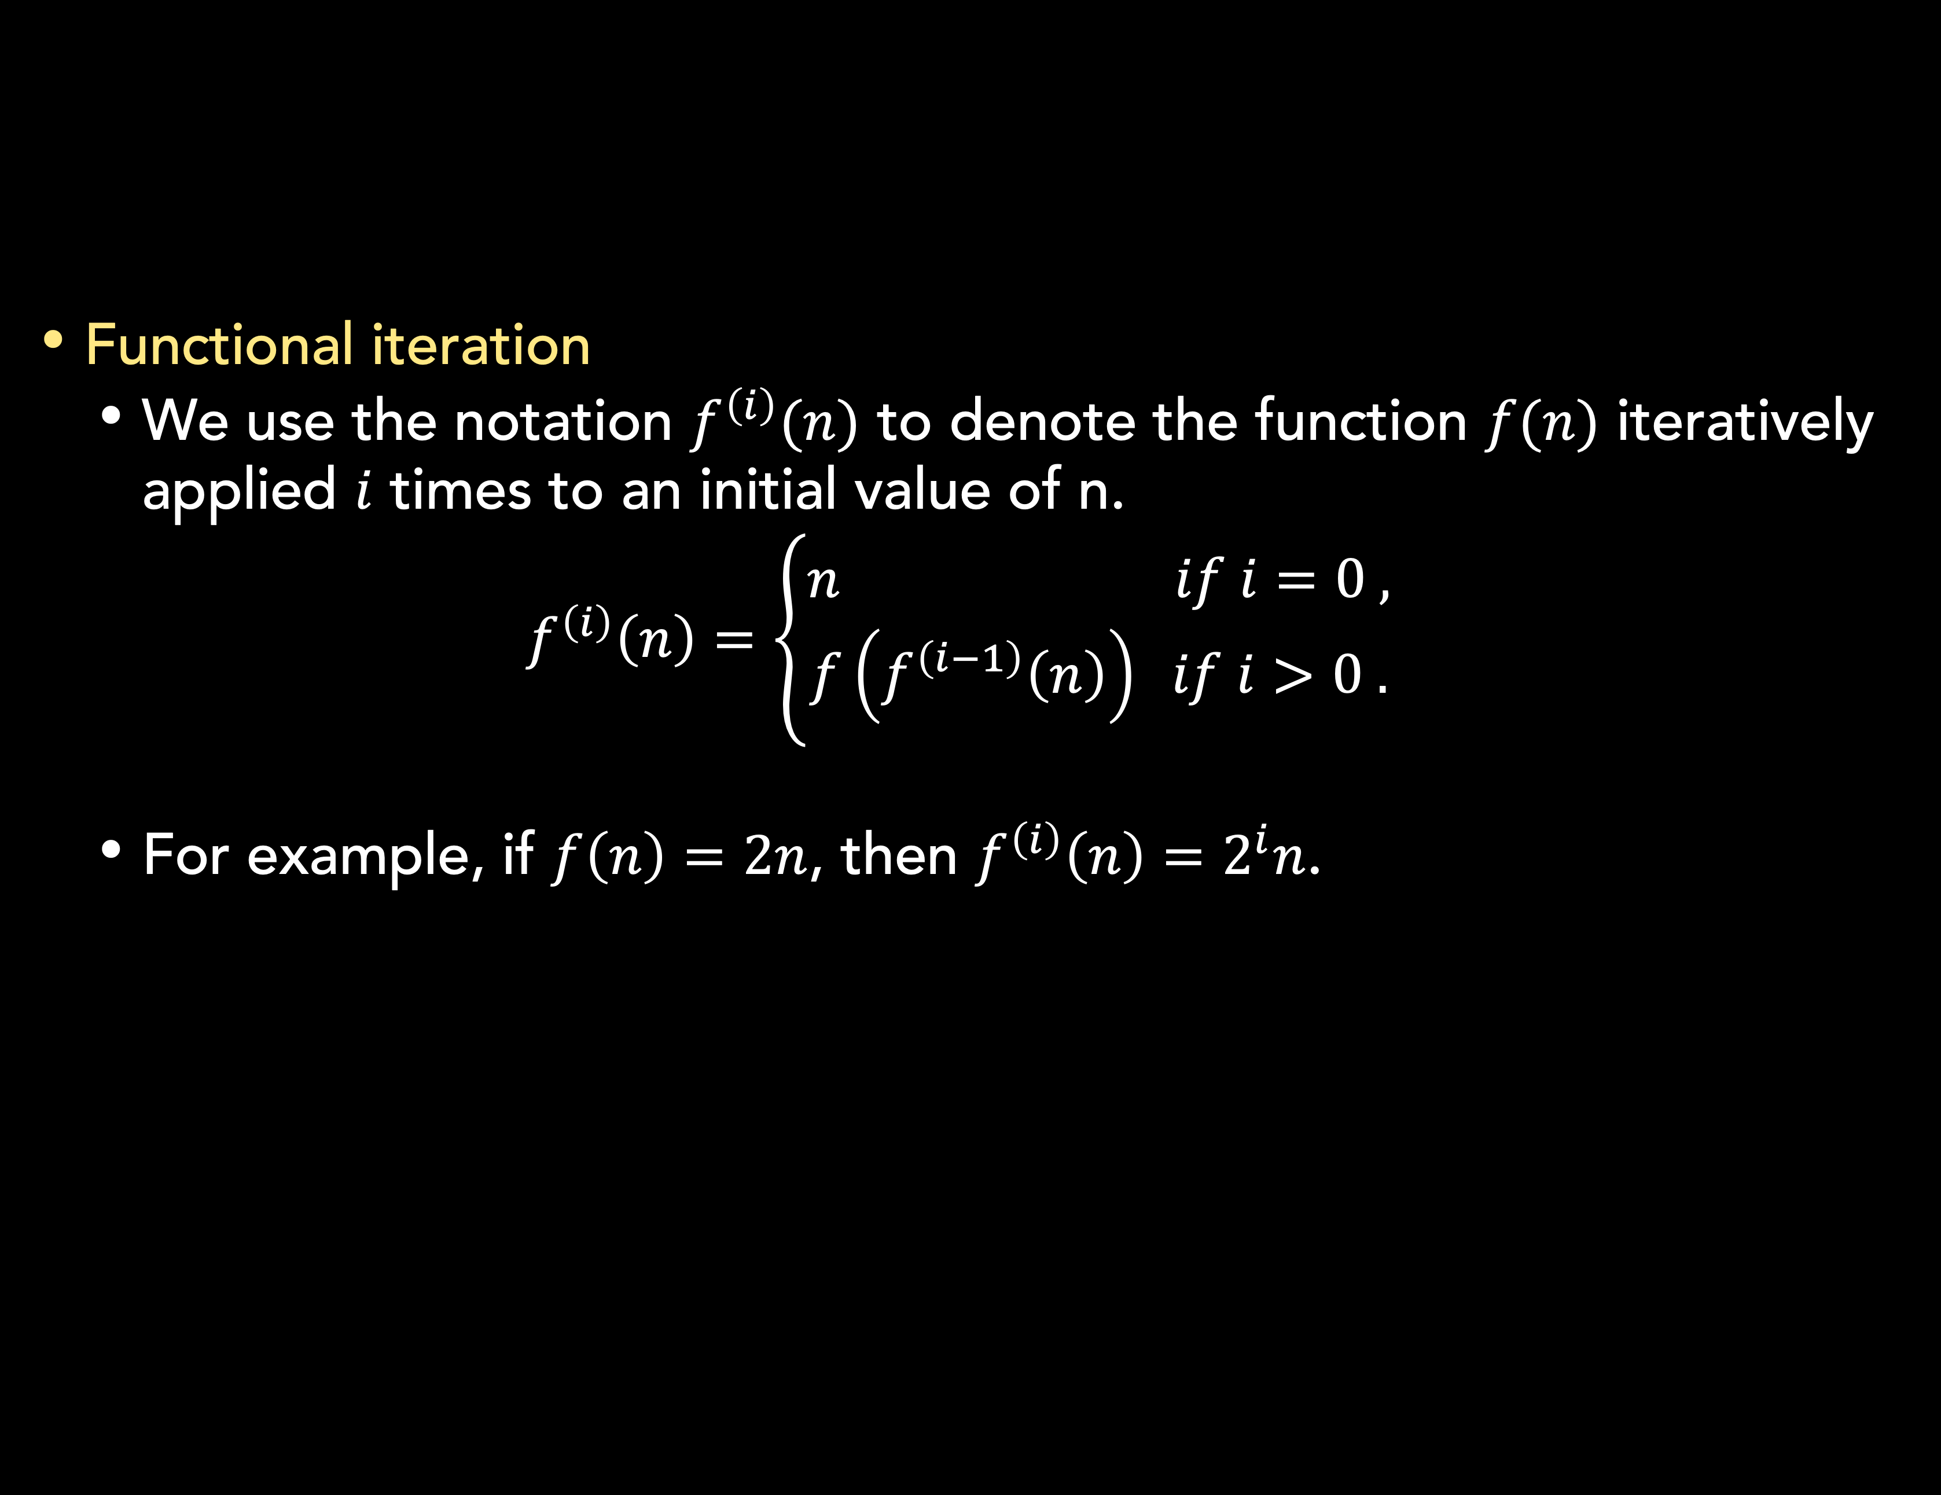
Standard notations and common functions
Mathematical functions and notations
Functional iteration
We use the notation $f^{\left(i\right)}(n)$ to denote the function $f(n)$ iteratively applied $i$ times to an initial value of n.
$$f^{\left(i\right)}\left(n\right)=\left\{\begin{aligned}n if i=0 , \\ f\left(f^{\left(i−1\right)}\left(n\right)\right) if i>0 .\end{aligned}\right.$$
For example, if $f\left(n\right)=2n$, then $f^{\left(i\right)}\left(n\right)=2^{i}n$.

Slide 31
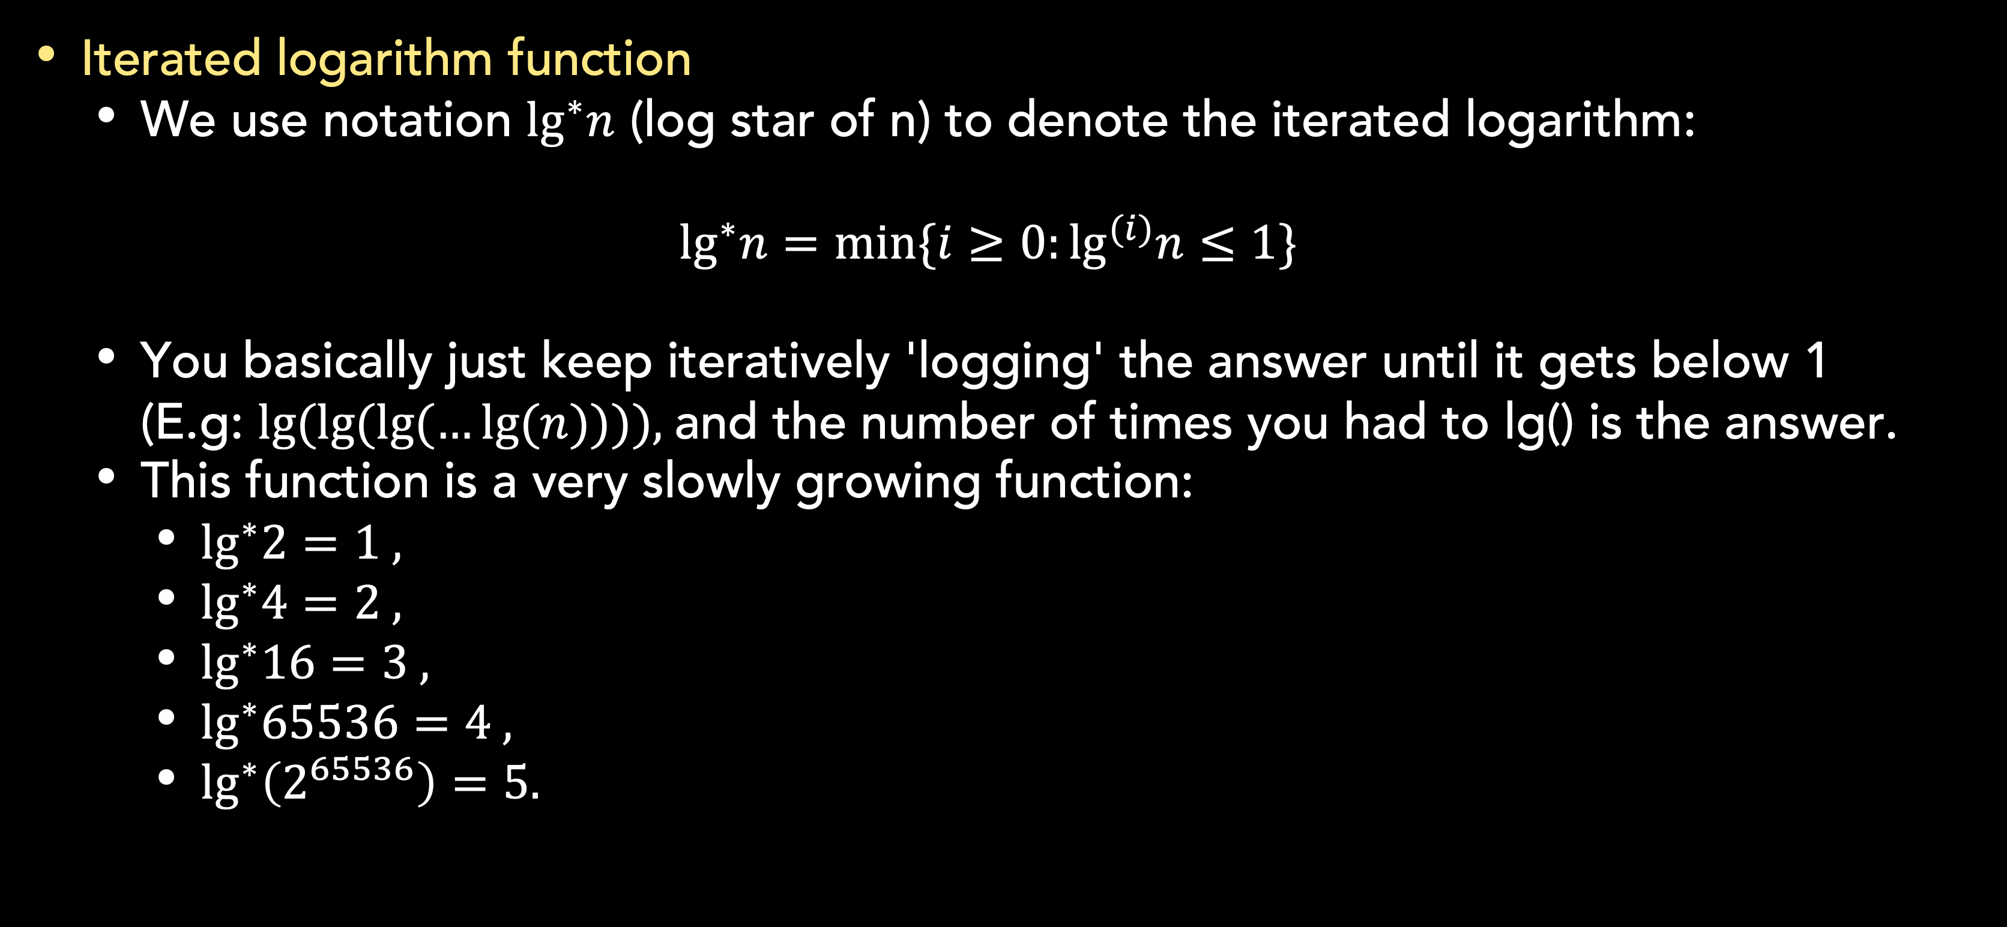
Standard notations and common functions
Mathematical functions and notations
Iterated logarithm function
We use notation $\lg^{∗}n$ (log star of n) to denote the iterated logarithm:
$$\lg^{∗}n=min⁡\{i≥0:\lg^{(i)}n≤1\}$$
You basically just keep iteratively 'logging' the answer until it gets below 1 (E.g: $lg⁡(lg⁡(lg⁡(…lg⁡(n)))),$and the number of times you had to lg() is the answer.
This function is a very slowly growing function:
$\lg^{∗}2=1 ,$
$\lg^{∗}4=2 ,$
$\lg^{∗}16=3 ,$
$\lg^{∗}65536=4 ,$
$\lg^{∗}\left(2^{65536}\right)=5.$

Slide 32
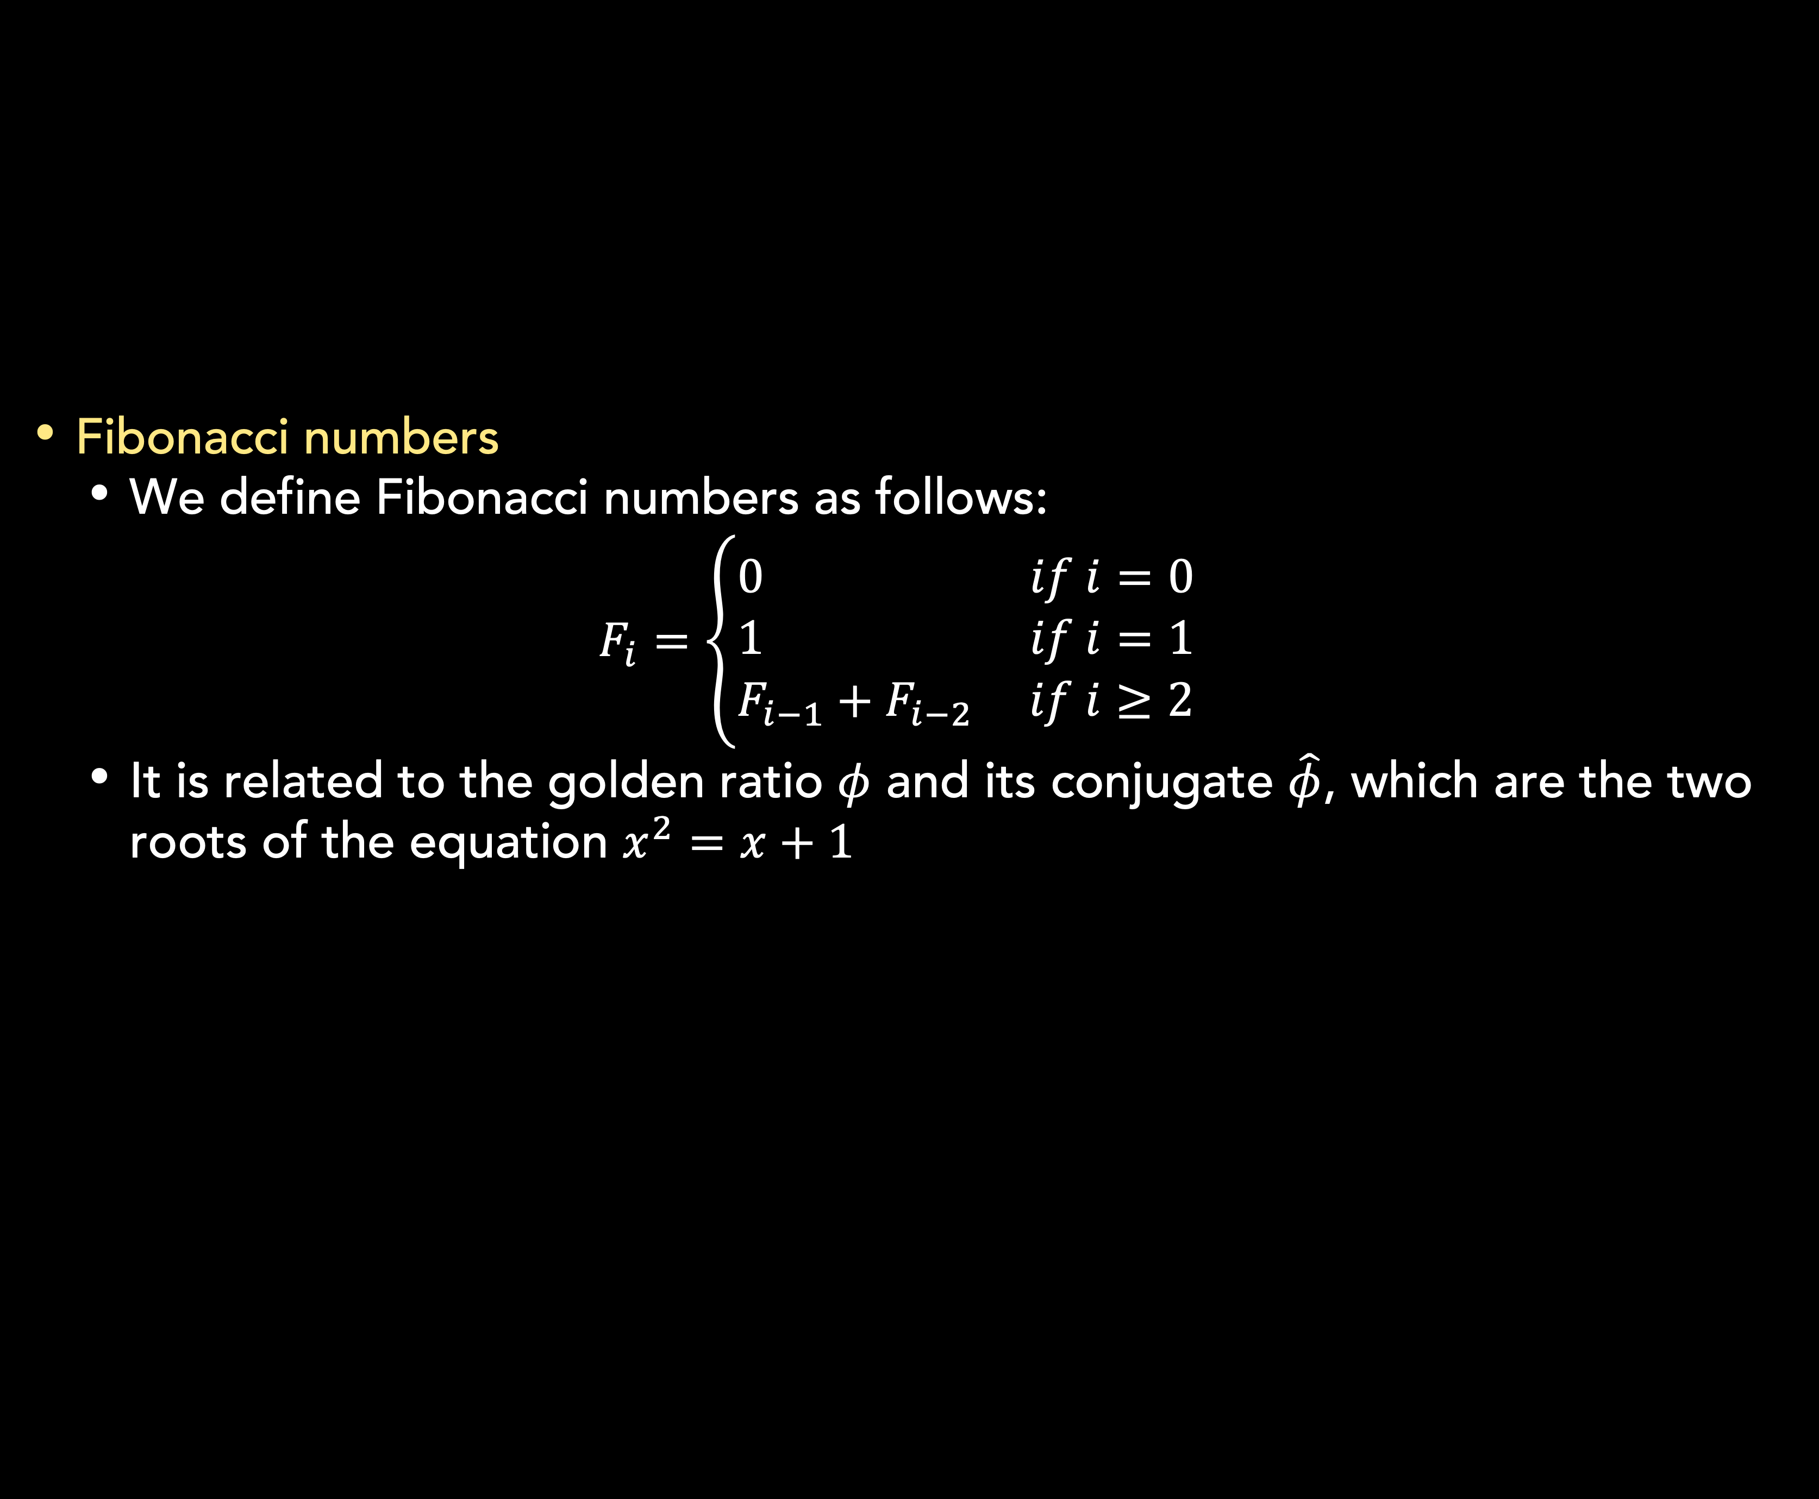
Standard notations and common functions
Mathematical functions and notations
Fibonacci numbers
We define Fibonacci numbers as follows:
$$F_{i}=\left\{\begin{aligned}0 if i=0 \\ 1 if i=1 \\ F_{i−1}+F_{i−2} if i≥2\end{aligned}\right.$$
It is related to the golden ratio $φ$ and its conjugate $\hat{φ}$, which are the two roots of the equation $x^{2}=x+1$

Slide 33

Summary
The asymptotic notations such as $Ο, Ω, Θ$ are designed so that they characterize functions in general.
O-notation characterizes an upper bound, $Ω$-notation characterizes a lower bound, and $Θ$-notation characterizes tight bound.
Several mathematical functions and notations:
Monotonicity
Polynomials
Exponentials
Logarithms
Factorials
Functional iteration
The iterated logarithm function
Fibonacci numbers

Slide 34
Exercises
04
Calculate and EXPLAIN the complexity of algorithm below:
F(n) = {
count = 0 FOR i = 1 to n DO
IF n MODULO i = 0 THEN
count = count + 1
END IF
END FOR
IF count = 2 THEN
RETURN PRIME
ELSE
RETURN NOT-PRIME
END IF
}

Slide 35
Exercises
04
Calculate and EXPLAIN the complexity of algorithm below:
F(n) = F(n/3) +1
with F(0) is 0
Calculate and EXPLAIN the complexity of function that calculate the n-th Fibonacci number.
F(n) = F(n-1) + F(n-2)

Slide 36
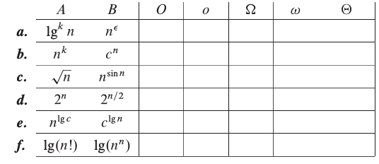
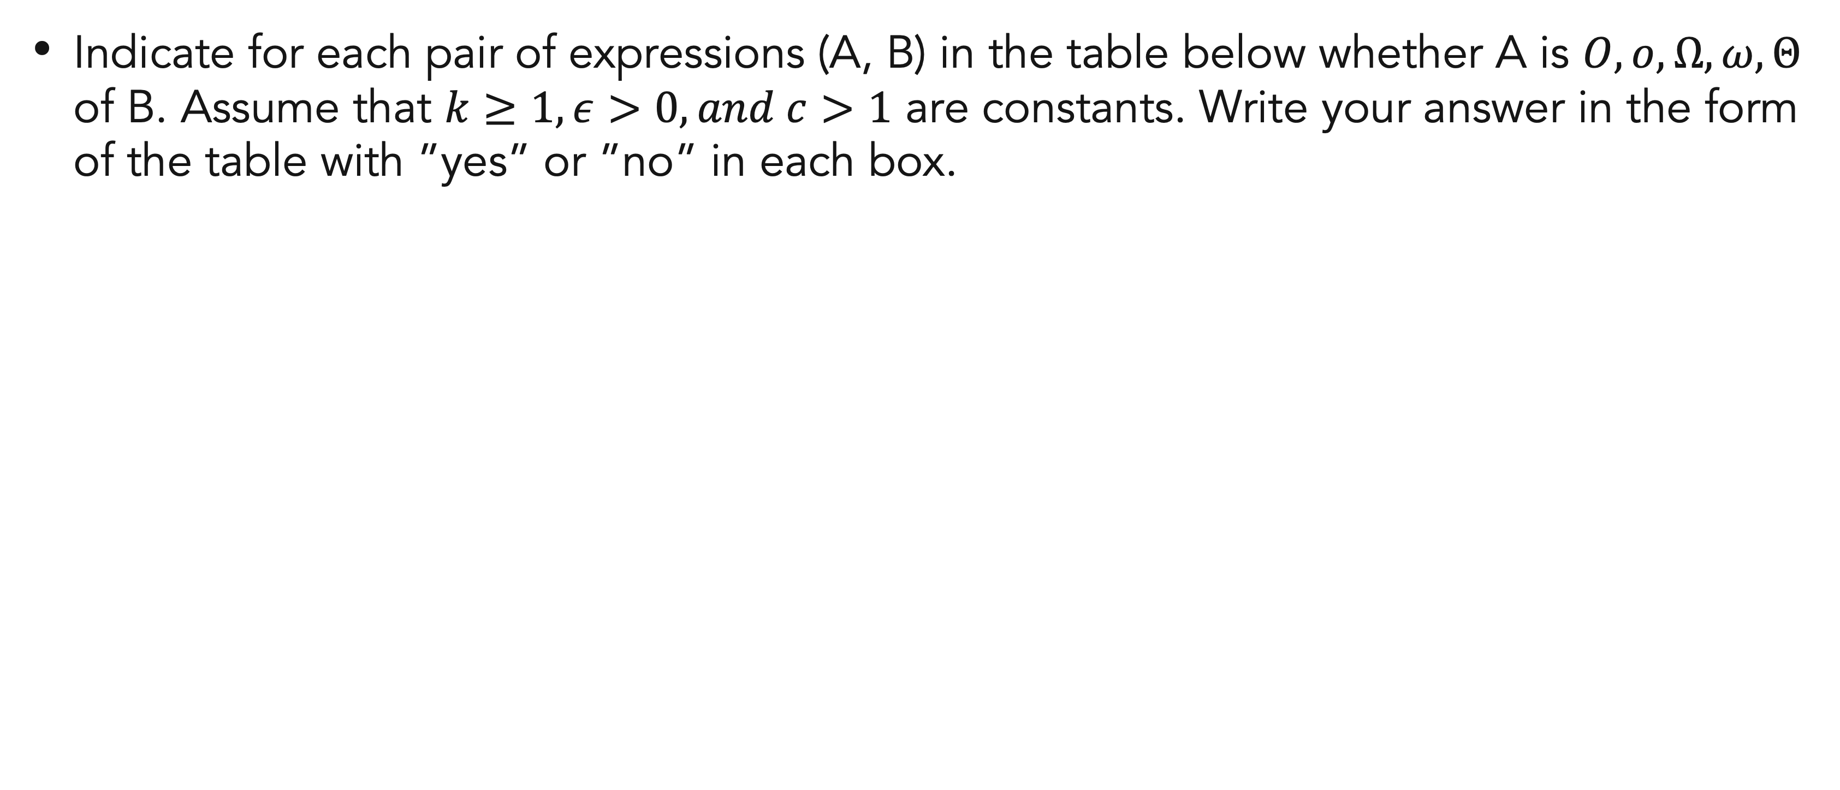
Exercises
04
Indicate for each pair of expressions (A, B) in the table below whether A is $O, o, Ω, ω, Θ$ of B. Assume that $k≥1, ε>0, and c>1$ are constants. Write your answer in the form of the table with ”yes” or ”no” in each box.

Slide 37
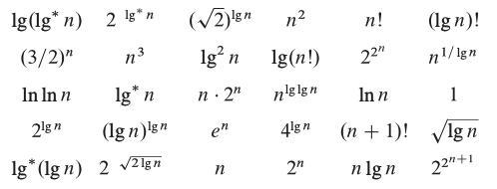
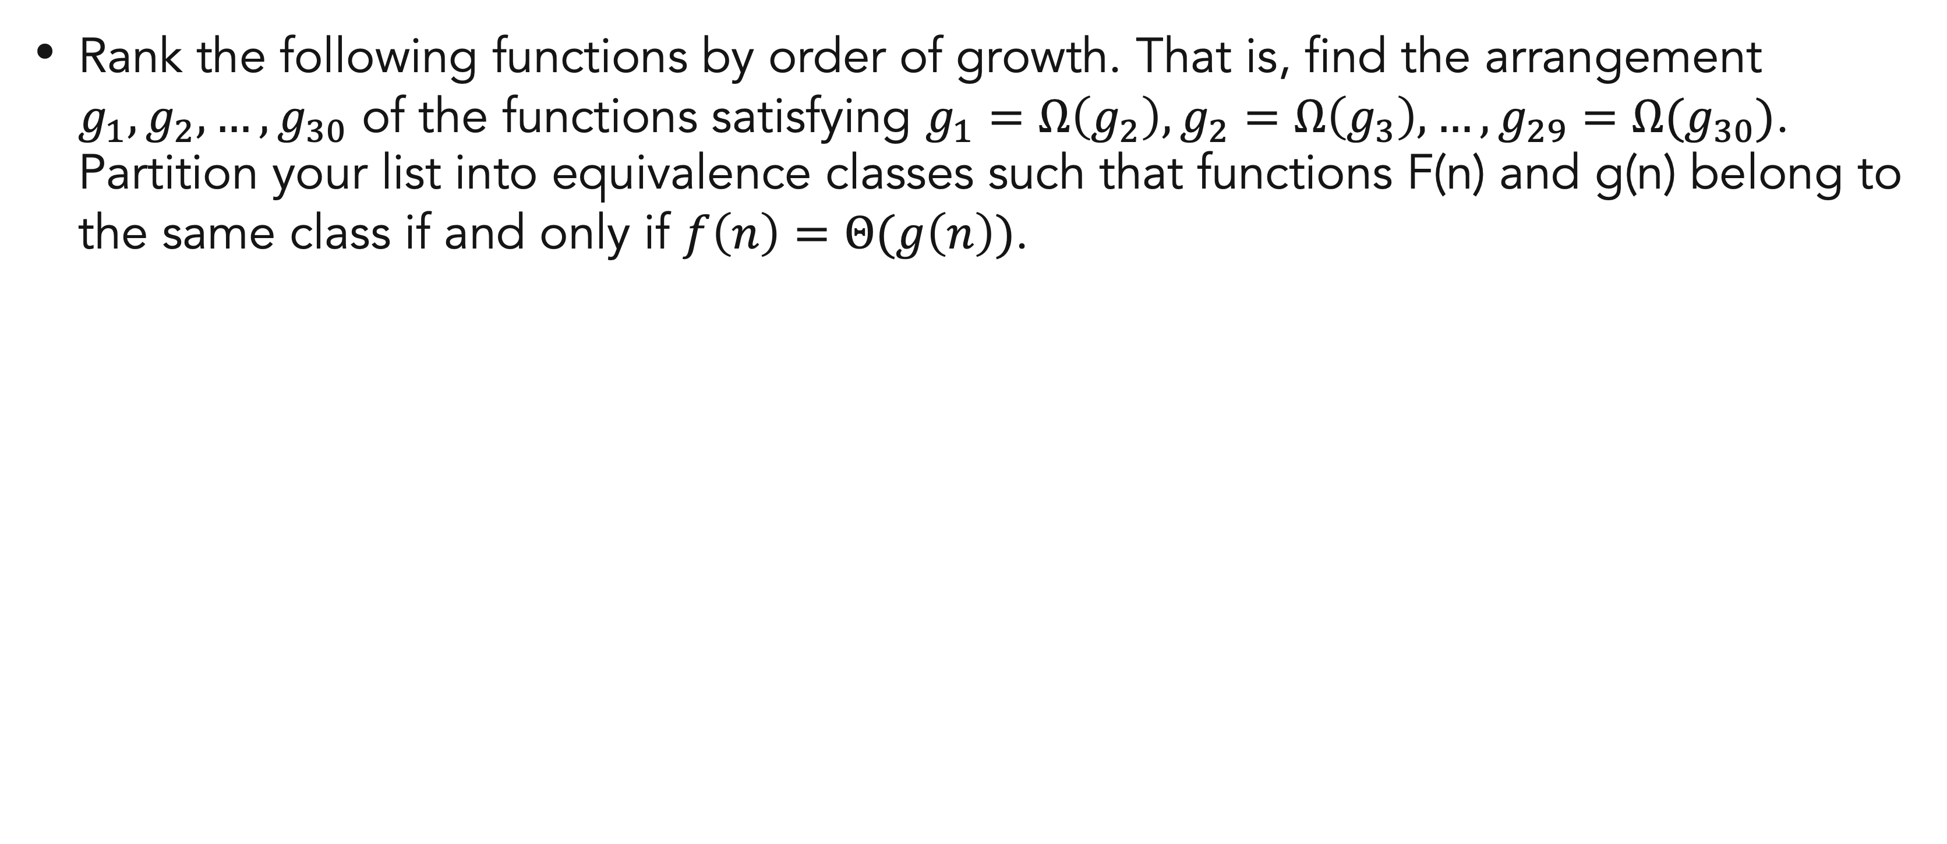
Exercises
04
Rank the following functions by order of growth. That is, find the arrangement $g_{1},g_{2},…,g_{30}$ of the functions satisfying $g_{1}=Ω\left(g_{2}\right),g_{2}=Ω\left(g_{3}\right), …,g_{29}=Ω(g_{30})$. Partition your list into equivalence classes such that functions F(n) and g(n) belong to the same class if and only if $f\left(n\right)=Θ(g\left(n\right))$.

Slide 38
References
Thomas H. Cormen. (2022). Introduction to algorithms: Fourth edition. The MIT Press. Chapter 3.
S. Sridhar. 2015. Design and Analysis of Algorithms, 1/e. Oxford University Press. India. Chapter 18

Slide 39
Thank you
Characterizing Running Times
September, 2023

